Slide 1


ART SUPPLIES
$5.00
What do you know?
Generate some questions that could be asked using this information.
What strategies might we use to answer some of the mathematical questions?

Slide 2
COLORED PENCILS
$5.00
What is the cost of
12 pencils? 2 pencils? 10 pencils? 50 pencils?
Be prepared to explain how you figured them out.
# of pencils
cost of pencils
4
12
2
10
50
$5.00
$15.00
$2.50
$12.50
$62.50

Slide 3
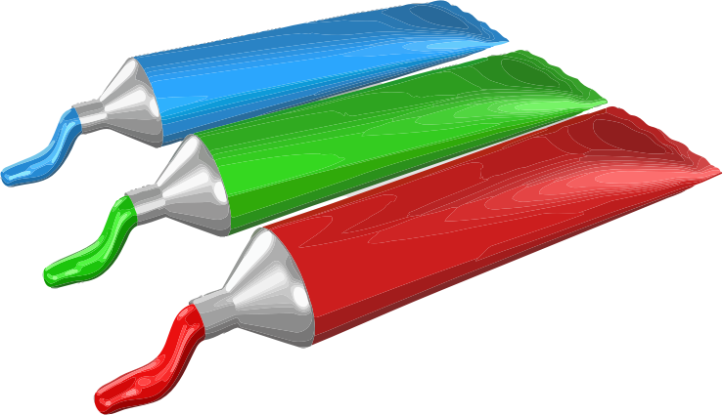
PAINTS
$4.50
What is the cost of
12 tubes? 1 tube? 54 tubes? 100 tubes?
0 3 6 9 12
1
# of tubes
Cost (dollars)
0 4.50 9.00 13.50 18.00
1.50
unit price

